Slide 1
Healthcare in Retirement
Seniority Benefit Group is a licensed health insurance agency and not affiliated with or endorsed by the Government or Federal Medicare program.
Medicare guidance at no-cost to you!

Slide 2
Independent LOCAL Medicare guidance Firm
Headquartered in Dublin Ohio
Entirely MEDICARE Focused
Represent over 15,000+ senior clients
KNOWLEDGE of Local Plans and Physician Networks
Medicare guidance at no-cost to you!

Slide 3
Today’s Agenda
What to Expect When Turning 65
Understanding the Basics of Medicare
Options for Coverage
Estimated Costs
How Do You Apply for Medicare?
Enrollment Periods
Income Related Monthly Adjusted Amount (IRMAA)
ShopYourPlan.com
Medicare guidance at no-cost to you!

Slide 4
You’re Turning 65 or Considering Retirement…
Medicare guidance at no-cost to you!

Slide 5
Options for Coverage
Original Medicare Parts A & B
Continue to Work and Keep Employer Plan
VA | TRICARE
Work Retiree Plan
⇒
Medicare guidance at no-cost to you!

Slide 6
Medicare Supplement and Prescription Drug
Plan
This is where we can help!
Medicare Advantage
Plan
Medicare guidance at no-cost to you!

Slide 7
Medicare Supplement (Medigap)
Federally standardized private insurance plans that help fill in the gaps in Medicare Parts A & B
Does not cover outpatient prescription drugs (Part D)
Keep your doctor and hospitals as long as they accept Medicare
Premiums are based on age | gender | smoking status
Higher monthly premiums resulting in lower out-of-pocket expenses
Medicare guidance at no-cost to you!

Slide 8
Part D (Prescription Drug Plan)
Must be purchased through a private insurance company approved by Medicare
Prescription drug formularies vary by company and change annually
Purchased separately as stand-alone or often included with Medicare Advantage Plans
Medicare guidance at no-cost to you!

Slide 9
2023 Prescription Drug Stages
Deductible
You pay 100% of your medication cost until you reach the deductible
Initial
You pay a copay for medication and plan covers the rest
You pay 25% of the cost for covered brand-name and generic medication
Donut Hole
Catastrophic
You pay the greater of 5% of the medication cost
Medicare guidance at no-cost to you!

Slide 10
Medicare Advantage (Part C)
Medicare Advantage Plans replace Original Medicare
Deliver the same benefits (or more) as original Medicare Parts A & B
Plans are sold by private insurance companies
Use network doctors and hospitals (HMO | PPO)
Most plans offer prescription drug coverage
May include extra benefits such as dental, vision, hearing & gym memberships
Several $0 plans available in area
Snowbird provision
Medicare guidance at no-cost to you!

Slide 11
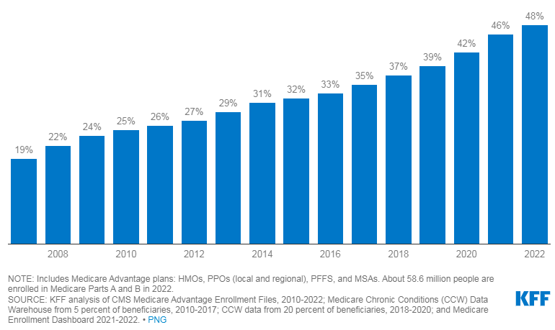
Medicare Advantage Enrollment
1999 - 2022

Slide 12
Estimated Costs at Age 65
Original Medicare Parts A & B
(Standard Monthly Premium)
$164.90
Medicare Supplement Plan G
Original Medicare (A & B)
$164.90
Medicare Supplement
$133.00
Part D
$33.19
Medicare Advantage
Original Medicare (A & B)
$164.90
Medicare Advantage
$0 & Above
$331.09
$164.90
Medicare guidance at no-cost to you!

Slide 13
Income Related Monthly Adjusted Amount
(IRMAA)
Medicare guidance at no-cost to you!

Slide 14
Based on yearly income
IRMAA is a surcharge added to Part B & Part D premiums
Uses income tax information from 2 years prior
Can appeal if:
- There was an error in tax information used
- Life changing event that reduced your income
Medicare guidance at no-cost to you!

Slide 15
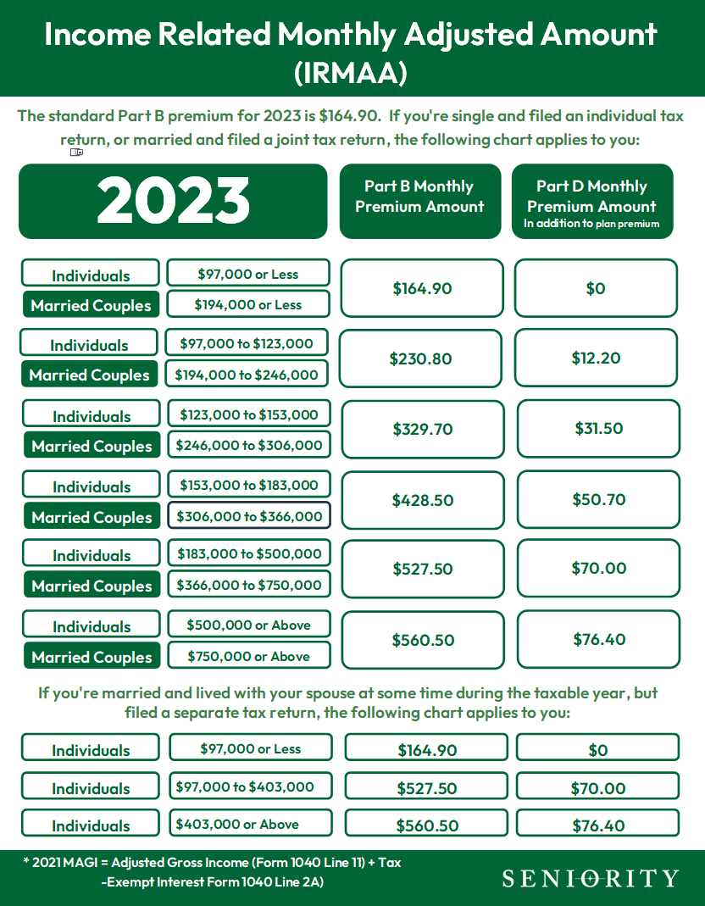
IRMAA Income Related Monthly Adjusted Amount
Medicare guidance at no-cost to you!

Slide 16
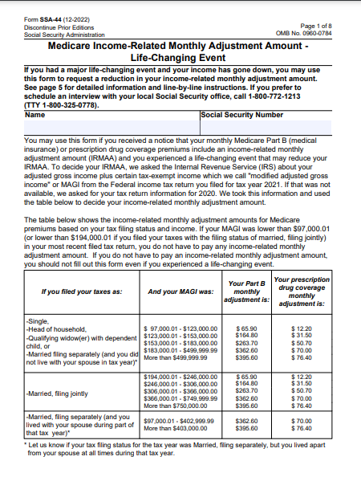
Life Changing Event Form
IRMAA Income Related Monthly Adjusted Amount
Medicare guidance at no-cost to you!

Slide 17
How Do You Apply for Medicare?
I AM
You will receive a Medicare card 3 months prior to your 65th birthday. If you don’t decline, you will be automatically enrolled
RECEIVING SOCIAL SECURITY BENEFITS
I AM NOT
Establish my Social Security account at www.ssa.gov
RECEIVING SOCIAL SECURITY BENEFITS
Apply online at www.medicare.gov
Make a telephone appointment at your local Social Security office
Medicare guidance at no-cost to you!

Slide 18
Enrollment Periods
Retiring After 65
Special Enrollment Period
Turning 65
Initial Enrollment Period
3 Months Before
3 Months After
3 Months Before
3 Months Before
3 Months After
Happy 65th Birthday
Month of
Month of
Month of
Medicare guidance at no-cost to you!

Slide 19
We are pleased to introduce…
powered by:
Medicare guidance at no-cost to you!

Slide 20
ShopYourPlan.com
Welcome to Seniority’s Medicare options tool
Built to ensure our clients get the time, expertise they need when it comes to Medicare.
We help our clients find the right Medicare plan through education, personal consultation and easy to use online enrollment tools.
ShopYourPlan.com/Kerry
Medicare guidance at no-cost to you!

Slide 21
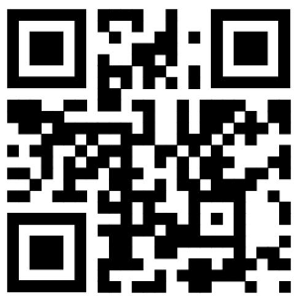
Take advantage of our no-cost Medicare guidance!
Scan the QR code below with your phone’s camera to get started!
Kerry Quick
Benefit Advisor
614.799.1403 ext. 229
quick@sbg65.com
ShopYourPlan.com/Kerry
Medicare guidance at no-cost to you!

